Slide 1
Cloud Testing
Day 3

Slide 2
Learning outcomes
To know the various services offered by AWS, Azure, GCP
To compare the services offered by AWS, Azure, GCP
To understand how to test some of the most used services of AWS, Azure, GCP as a part of Cloud testing strategy.

Slide 3
Cloud testing is a subset of software testing in which simulated, real-world Web traffic is used to test cloud-based Web applications. Cloud testing also verifies and validates specific cloud functions, including redundancy and performance scalability.

Slide 4
IaaS
Infrastructure as a Service (IaaS)
Hardware: servers, data storage systems and network equipment.
Operating systems and system software.
Software to control the provided services.

Slide 5
PaaS
Platform as a Service (PaaS)
Execution environment.
Development environment.
Team development services: version control, task management and issue-tracking systems.
Testing environment.

Slide 6
SaaS
Software as a Service (SaaS)
Access to services (for example, Microsoft Office Live, Google Docs, Gmail) implemented as one or several applications.
Updates of applications that provide the services (transparent for service customers).
Technical support.

Slide 7
AWS vs Azure vs Google
https://www.datamation.com/cloud-computing/aws-vs.-azure-vs.-google-cloud-comparison.html

Slide 8
AWS vs Azure vs Google
In the public cloud computing market, three vendors dominate: Amazon Web Services (AWS), Microsoft Azure and Google Cloud Platform (GCP). When it comes to infrastructure as a service (IaaS) and platform as a service (PaaS), these three have a huge lead on the rest of the field.

Slide 9
Amazon is particularly dominant. In a Q3 2017 report, Synergy Research Group noted that "Microsoft, Google and Alibaba are all growing their revenues much more rapidly than Amazon and they continue to gain market share, but the reality is that in this market Amazon remains bigger than its next five largest competitors combined."

Slide 10
Many experts recommend that enterprises evaluate their public cloud needs on a case-by-case basis and match specific applications and workloads with the vendor that offers the best fit for their needs. Each of the leading vendors has particular strengths and weaknesses that make them a good choice for certain projects.

Slide 11
AWS pros and cons
Amazon's biggest strength is its dominance of the public cloud market. In its June 2017 Magic Quadrant for Cloud Infrastructure as a Service, Worldwide Gartner noted, "AWS has been the market share leader in cloud IaaS for over 10 years.“
Reason for its popularity is undoubtedly the massive scope of its operations.
AWS has a huge and growing array of available services, as well as the most comprehensive network of worldwide data centers.
The Gartner report summed it up, saying, "AWS is the most mature, enterprise-ready provider, with the deepest capabilities for governing a large number of users and resources.”

Slide 12
AWS pros and cons
Amazon's big weakness relates to cost. While AWS regularly lowers its prices, many enterprises find it difficult to understand the company's cost structure and to manage those costs effectively when running a high volume of workloads on the service.
In general, however, these cons are more than outweighed by Amazon's strengths, and organizations of all sizes continue to use AWS for a wide variety of workloads.

Slide 13
Microsoft Azure pros and cons
Microsoft came late to the cloud market but gave itself a jump start by essentially taking its on-premises software – Windows Server, Office, SQL Server, Sharepoint, Dynamics Active Directory, .Net, and others – and repurposing it for the cloud.
Reason for Azure’s success has to do with the fact that so many enterprises deploy Windows and other Microsoft software.
Because Azure is tightly integrated with these other applications, enterprises that use a lot of Microsoft software often find that it also makes sense for them to use Azure building loyalty for existing Microsoft customers.
Discounts off service contracts for existing customers.

Slide 14
Microsoft Azure pros and cons
Gartner finds fault with some of the platform's imperfections. "While Microsoft Azure is an enterprise-ready platform, Gartner clients report that the service experience feels less enterprise-ready than they expected, given Microsoft's long history as an enterprise vendor," it said. "Customers cite issues with technical support, documentation, training and breadth of the ISV partner ecosystem."
In addition, Gartner said that Azure doesn't offers as much support for DevOps approaches as some of the other cloud platforms.
For example, it doesn't have as much integrated automation, requiring staff to perform many management tasks by hand.

Slide 15
Google Cloud Platform pros and cons
Google has a strong offering in containers, since Google developed the Kubernetes standard that AWS and Azure now offer. GCP specializes in high compute offerings like Big Data, analytics and machine learning. It also offers considerable scale and load balancing – Google knows data centers and fast response time.

Slide 16
Google Cloud Platform pros and cons
On the downside, Google is a distant third in market share, perhaps because it doesn't offer as many different services and features as AWS and Azure. It also doesn't have as many global data centers as AWS or Azure, although it is quickly expanding.
Gartner said that its "clients typically choose GCP as a secondary provider rather than a strategic provider, though GCP is increasingly chosen as a strategic alternative to AWS by customers whose businesses compete with Amazon, and that are more open-source-centric or DevOps-centric, and thus are less well-aligned to Microsoft Azure.”

Slide 17
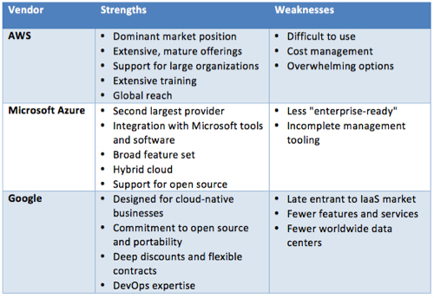

Slide 18
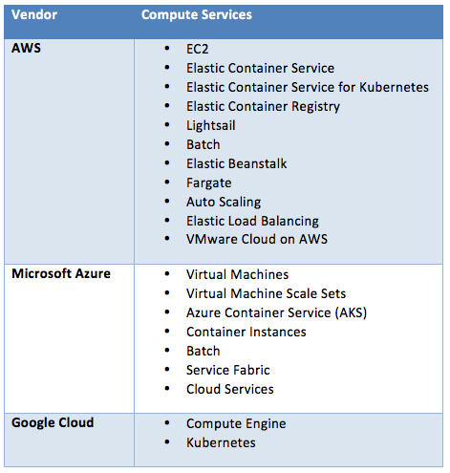

Slide 19
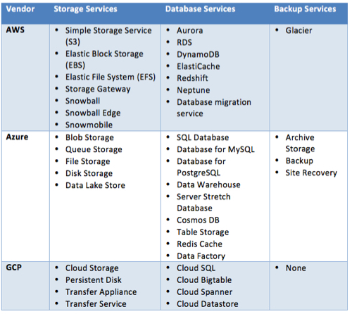

Slide 20
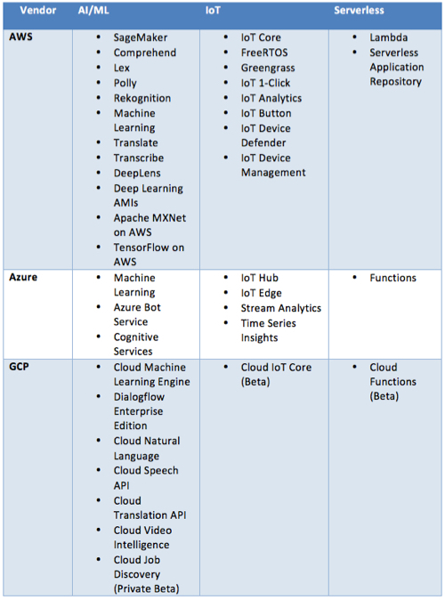

Slide 21
 | Amazon Web Services | Microsoft Azure | Google Cloud Platform
Regions | Global Infrastructure | Regions | Regions and Zones
Pricing | Cloud Services Pricing | Pricing | Pricing
Basic Compute | EC2 | Virtual Machines | Compute Engine
Containers | ECS EKS | AKS Container Instances | Kubernetes Engine
Serverless | Lambda | Functions | Cloud Functions
App Hosting | Elastic Beanstalk | App Service Service Fabric Cloud Services | App Engine

Slide 22
Batch Processing | Batch | Batch | N/A
Object Storage | S3 | Blob Storage | Cloud Storage
Block Storage | EBS | N/A | Persistent Disk
File Storage | EFS | File Storage | N/A
Hybrid Storage | Storage Gateway | StorSimple | N/A
Offline Data Transfer | Snowball Snowball Edge Snowmobile | N/A | Transfer Appliance
Relational/SQL Database | RDS Aurora | SQL Database Database for MySQL Database for PostgreSQL | Cloud SQL Cloud Spanner

Slide 23
NoSQL Database | DynamoDB | Cosmos DB Table Storage | Cloud Bigtable Cloud Datastore
In-Memory Database | Elasticache | Redis Cache | N/A
Archive/Backup | Glacier | Backup | N/A
Disaster Recovery | N/A | Site Recovery | N/A
Machine Learning | SageMaker AML Apache MXNet on AWS TensorFlow on AWS | Machine Learning | Cloud Machine Learning Engine

Slide 24
Cognitive Services | Comprehend Lex Polly Rekognition Translate Transcribe | Cognitive Services | Cloud Natural Language Cloud Speech API Cloud Translation API Cloud Video Intelligence
IoT | IoT Core | IoT Hub IoT Edge | Cloud IoT Core
Networking | Direct Connect | Virtual Network | Cloud Interconnect Network Service Tiers
Content Delivery | CloudFront | CDN | Cloud CDN

Slide 25
Big Data Analytics | Athena EMR Kinesis | HDInsight Stream Analytics Data Lake Analytics Analysis Services | Cloud Dataflow Cloud Dataproc
Authentication and Access Management | IAM Directory Service Organizations Single Sign-On | Active Directory Multi-Factor Authentication | Cloud IAM Cloud IAP
Security | GuardDuty Macie Shield WAF | Security Center | Cloud DLP Cloud Security Scanner

Slide 26
Application Lifecycle Management | CodeStar CodePipeline | Visual Studio Team Services Visual Studio App Center | N/A
Cloud Monitoring | CloudWatch CloudTrail | Monitor Log Analytics | Stackdriver
Cloud Management | Systems Manager Management Console | Portal Policy Cost Management | Stackdriver
AR & VR | Sumerian | N/A | N/A
Virtual Private Cloud | VPC | N/A | Virtual Private Cloud
Training | Training and Certification | Training | Training Programs
Support | Support | Support | Support
3rd Party Software and Services | Marketplace | Marketplace | Cloud Launcher Partner Directory

Slide 27
Cloud Testing Tool (BlazeMeter)
https://www.blazemeter.com/blog/automated-delivery-acceptance-test-nirvana

Slide 28
Exercise
We have a Whatsapp clone developed.
We anticipate that the developed app will be as popular as original Whatsapp.
This developed application will be hosted on Public Cloud (AWS/Azure/Google Cloud Platform)
Let us create a test strategy and test plan and sample test cases in context of “Cloud Testing”
Time duration: 45 mins.
Refer Day-2 presentation.
At the end of day’s session we will have a discussion and QnA session

Slide 29
Consider following points
Critical preparations required on Cloud
Software & Hardware environment
Scalability of hardware & Software capabilities
Internet Access, network speed
Smooth process of Build deployment
Functional Testing
Non-Functional Testing
Integration Testing
Regression Testing
Defect verifications
System Testing
Alpha, Beta & User acceptance Testing
Stress & Load Testing
Important parameters of Performance
Continuous verification of Performance
Scalability Testing: (A critical aspect of continuous performance verification)
Defect reporting, defect fixes & defect verification
Decisions on Tools, data & environment

Slide 30
Post Test

Slide 31
QnA

Slide 32
Thank you ☺

